Slide 1
Chatbot
Term Project

Slide 2
Team Members
G. Amrutha
A.S.L. Manasa
Inti Vamsi Priyanka
Team
CH.EN.U4CSE19103
CH.EN.U4CSE19148
5
CH.EN.U4CSE19152
Birat Chapagain
Rohit Kumar Sah
CH.EN.U4CSE19154
CH.EN.U4CSE19155

Slide 3
Overview
Tools
Applications
01
02
03
04
05
Introduction
Implementation
Demonstration

Slide 4
Let’s get Started
Its everywhere
G. Amrutha

Slide 5
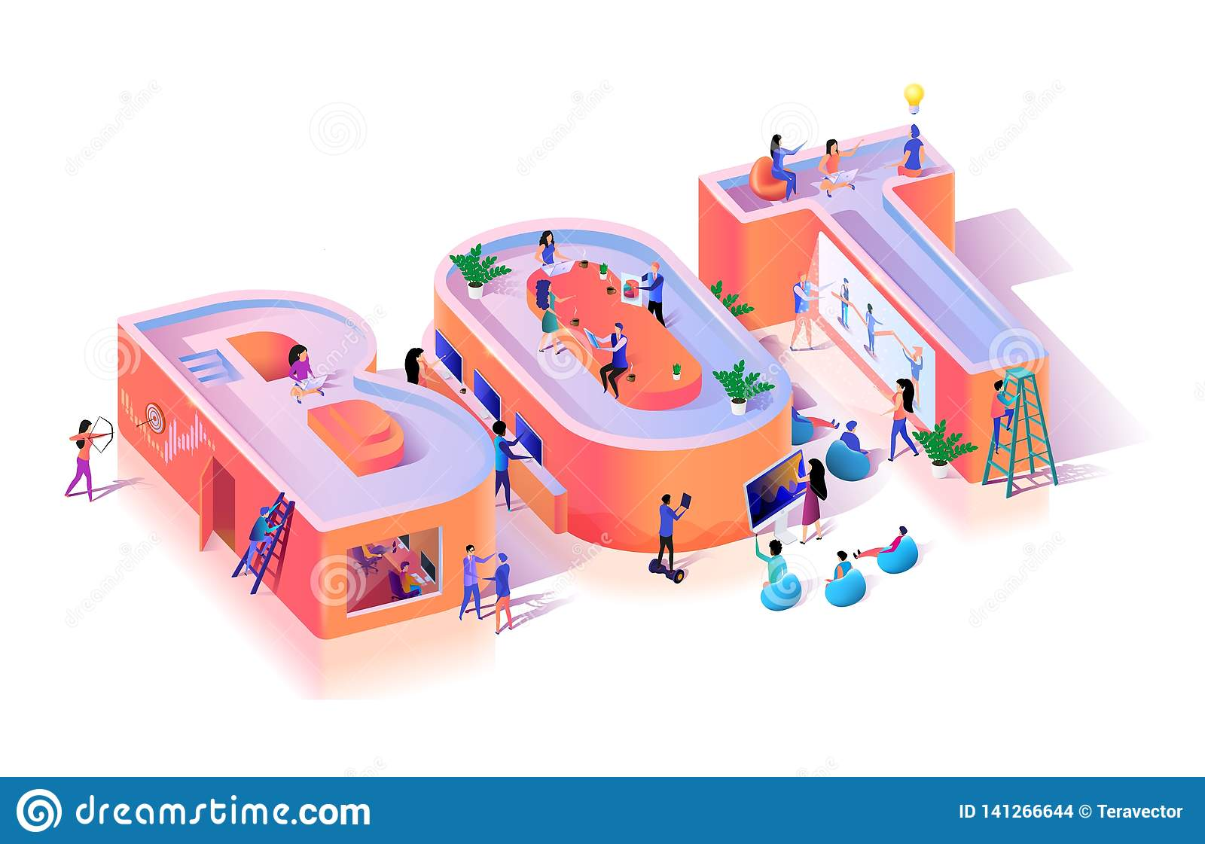
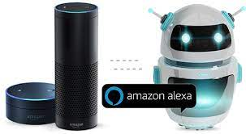
Abstract
Chatbots present a new way for individuals to interact with computer systems.
A chatbot allows a user to simply ask questions in the same manner that they would address a human.

Slide 6
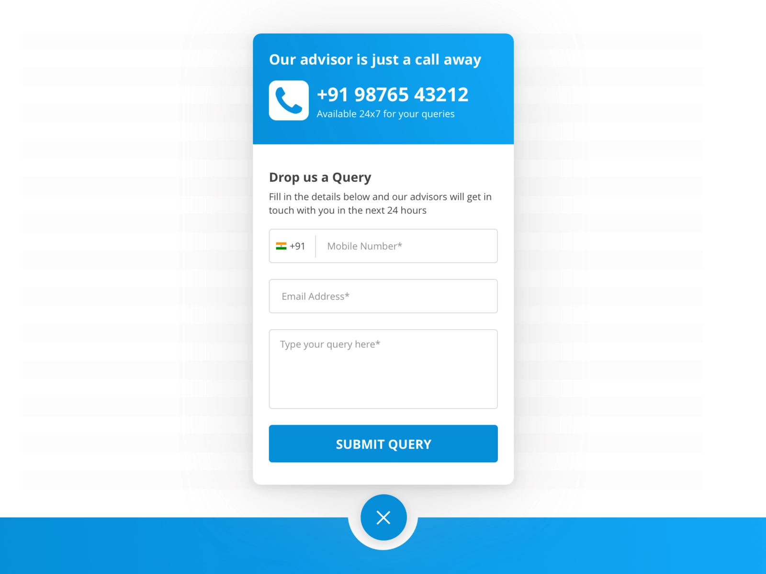
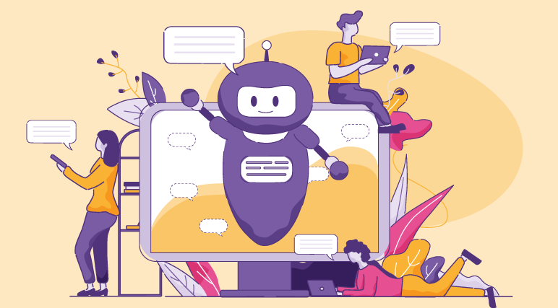
Traditional Way vs Modern Way

Slide 7
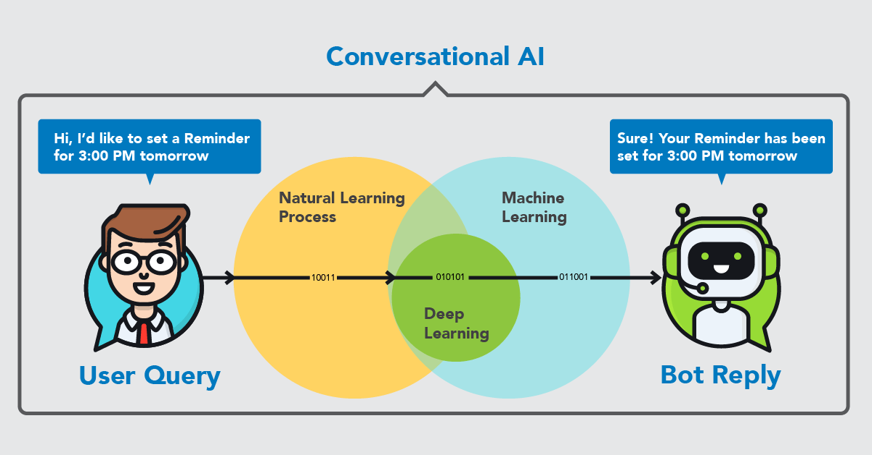
Introduction
Chat bot = Chatting with a robot
Types of chatbot
Task-oriented chatbot
Conversational chatbot
Concepts involved:
NLP
ML
DEEP LEARNING
AI

Slide 8

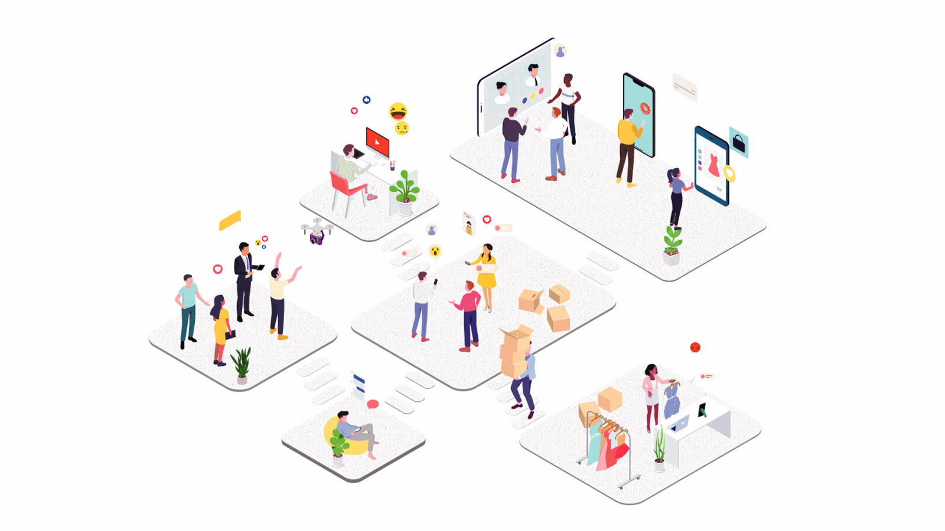
Motivation
Repetitive, boring tasks are tedious
to do.
Q:24/7 service is possible???
This question driven us to do our
chatbot project.
Elon Musk stated:
“Proposed tasks for the Tesla Bot are
ones that are dangerous, repetitive
and boring”

Slide 9
Dataset, Tools & Library Used
Birat Chapagain
Apparatus used !

Slide 10
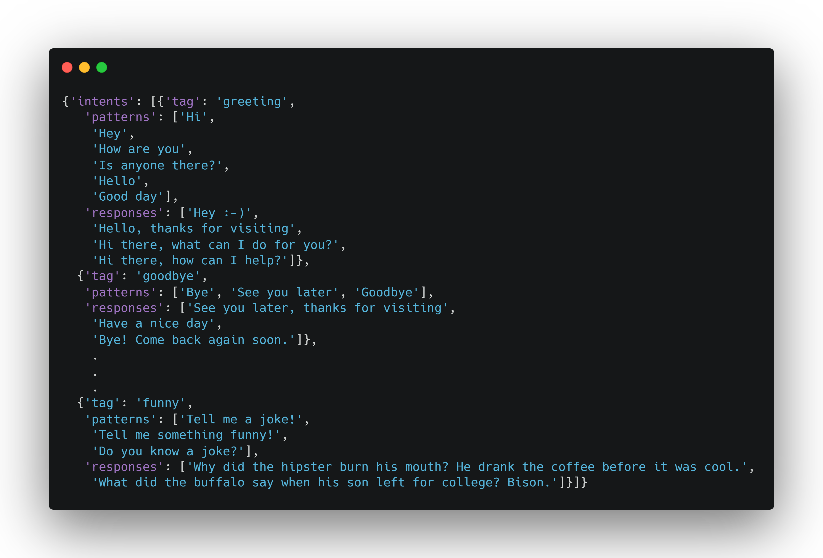
Dataset
2800 Intents
3126 Queries
26521 Responses

Slide 11
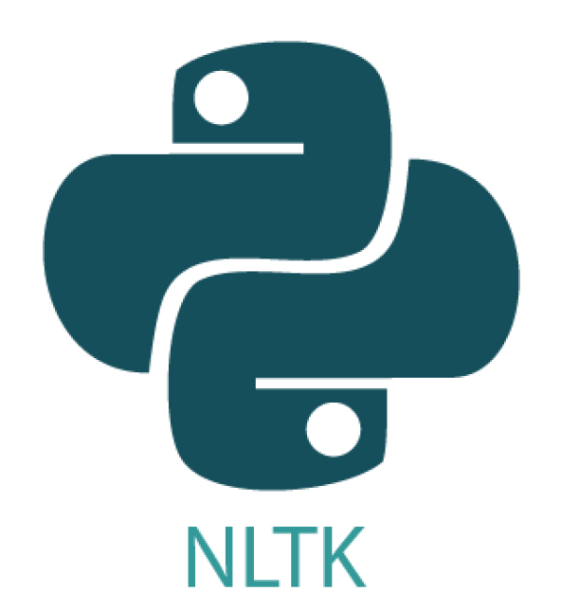


Model Training & Testing
Natural Language Toolkit
PyTorch
NumPy

Slide 12








Deployment & Frontend
Next.js
Flask
RESTful API
Charts.js
Framer
Axios

Slide 13
How does a Chabot works ?
Revealing the core of a chatbot
A.S.L. Manasa

Slide 14
What we will Discuss?
How are human languages processed by chatbots?
How are Chatbots Trained?
Architecture & Work Methods of Chatbots?

Slide 15
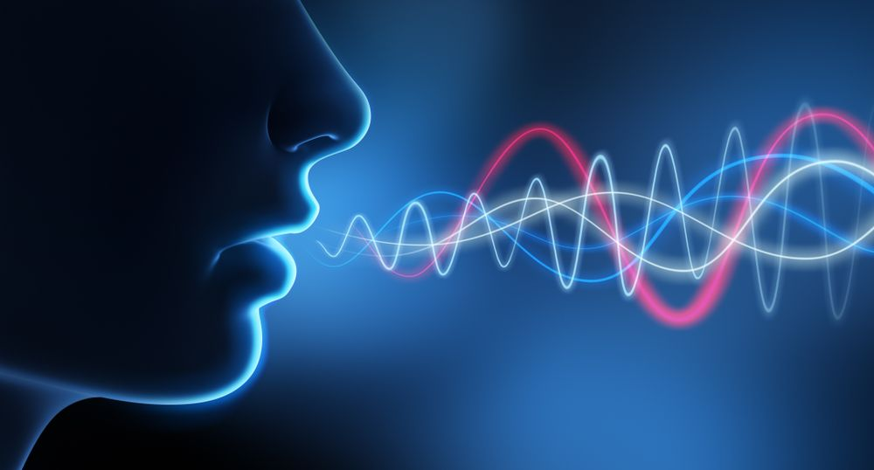
How are human languages processed by chatbots?
A chatbot is like a normal application. There is an app layer, a database and APIs to call other external administrations. Users can easily access chatbots, it adds intricacy for the application to handle.

Slide 16

How are Chatbots Trained?
Training a chatbot occurs at a considerably faster and larger scale than human education.

Slide 17
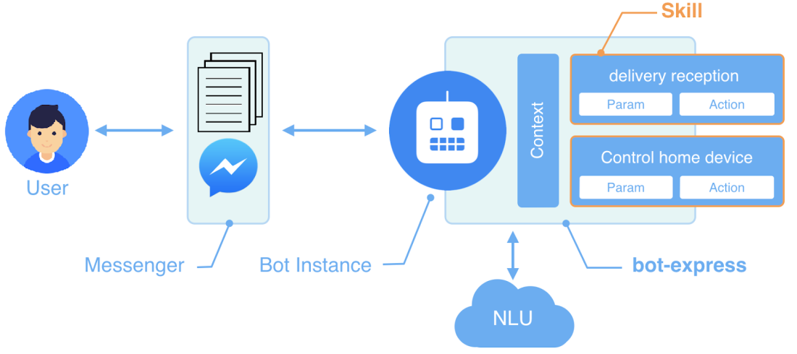
Architecture & Work Methods of Chatbots?
Pattern Matches
Natural Language Understanding (NLU)
Natural Language Processing (NLP)

Slide 18
Applications
Where can we use it for ?
Priyanka

Slide 19
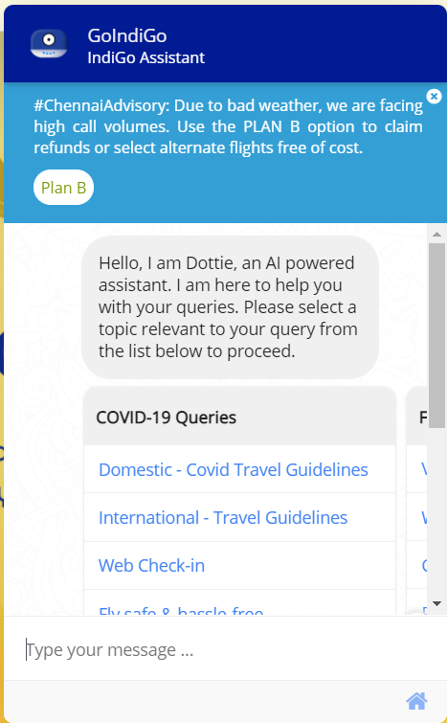
Application
Chatbots are currently being used in a variety of different contexts such as online customer support, phone interactions, information retrieval, or assisting with online commerce or tech support.
Indigo Airlines Chatbot

Slide 20
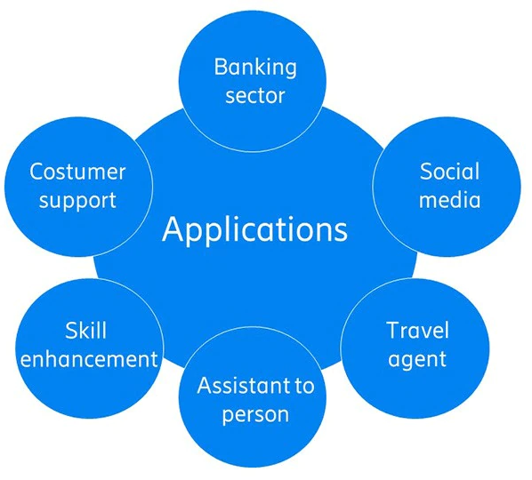
Application
Education environments
Customer service
Health
Robotics
Media and entertainment
Banking, finance, and fintech etc..

Slide 21
Research Work
Chatbots are probably one of the most innovative and convenient ways to customer support. Chatbots have become extremely popular over these years.
Here are the some of Research Works!!!!!!!
War Against the Machines: The Dark Side of Chatbots
Microsoft’s Tay & Zo: Even Bots Can Be Racist
Facebook’s Dialogue Agents: Going Off-Script

Slide 22
Demonstration
Rohit Sah
Jupyter Notebook !

Slide 23
http://ml-chatbot.vercel.app
You can experience out chatbot here.
Chat Logs
http://ml-chatbot.vercel.app/logs
Collected Data
Overall Bot Stats
http://ml-chatbot.vercel.app/api/logs
http://ml-chatbot.vercel.app/stats

Slide 24
Thanks
Any Queries?

